Slide 1


Slide 2


Bases de datos relacionales (SQL)

Slide 3
Agenda
0. Data Engineering Toolbox: ¿En qué etapa estamos?
Sistema de gestión de bases de datos relacionales (RDBMS) y lenguaje de consulta estructurado (SQL)
Usando un RDBMS (MySQL/PostgreSQL/SQLite)
Relaciones en las BD
CR SQL
UD SQL
Hands-On SQL

Slide 4


MySQL en Python:
Vamos a rockear!
Notes:
https://www.analyticsvidhya.com/blog/2018/11/data-engineer-comprehensive-list-resources-get-started/

Slide 5
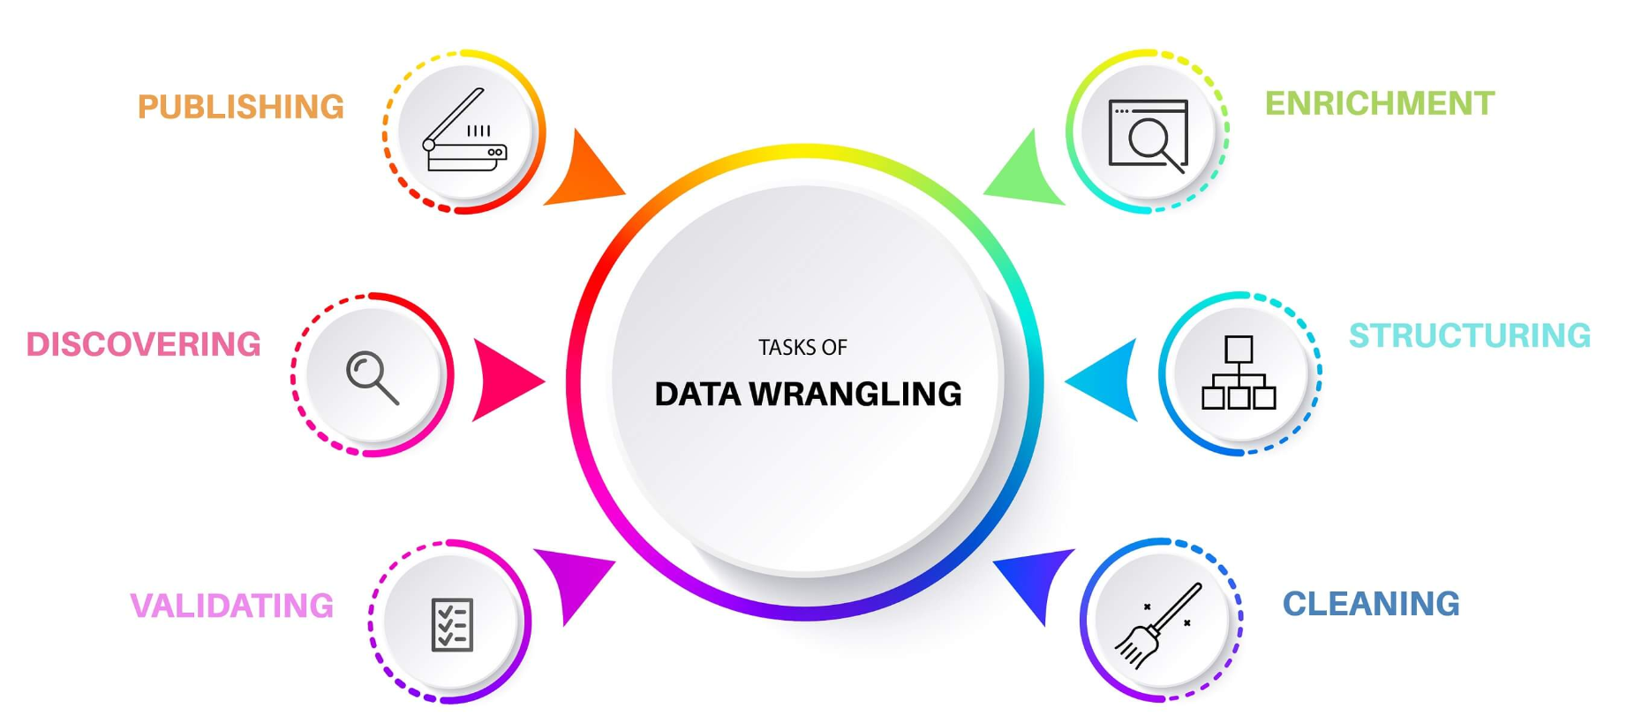
¿En qué etapa estamos?
Descubrimiento.
Estructura.
Limpieza.
Enriquecimiento.
Validación.
Publicación.

Slide 6
Data Engineering Toolbox: :
¿En qué etapa estamos?
Notes:
https://www.analyticsvidhya.com/blog/2018/11/data-engineer-comprehensive-list-resources-get-started/

Slide 7
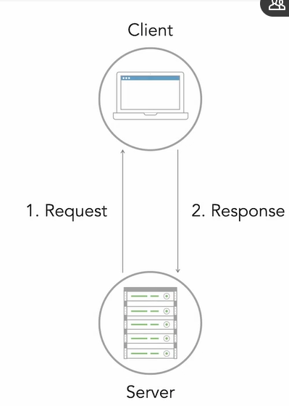
MySQL: Relational DB engine
mySQL sigue una paradigma Cliente-servidor
La DB reside en un servidor:
Peticiones se envían al server para acceder o modificar datos en el servidor .
Notes:
En vez de local files, mysql funciona levantando un servidor

Slide 8
MySQL: config
Para poder usar MySQL y enviarle peticiones, es necesario instalar y conectar el driver correcto

Slide 9
MySQL vs SQL
MySQL no es lo mismo SQL
MySQL es una RDBMS
SQL es un query language usado para interactuar directamente con DBs

Slide 10
https://dev.mysql.com/downloads/mysql/

Slide 11
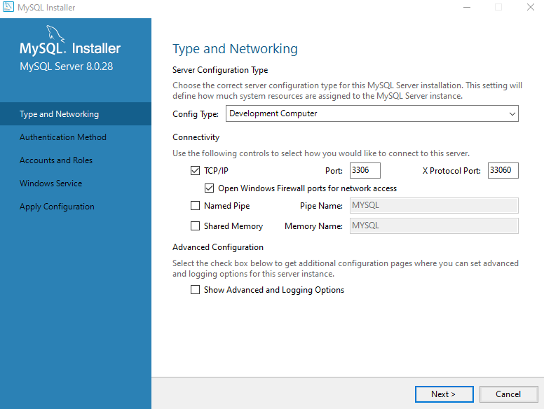
MySQL instalacion

Slide 12
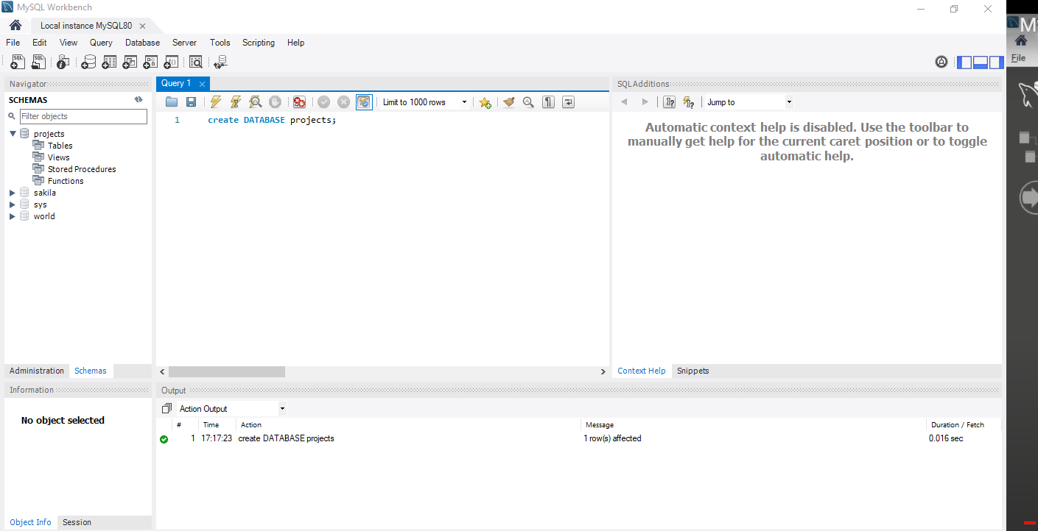
MySQL instalacion

Slide 13
1. Bases de datos relacionales
Notes:
https://www.analyticsvidhya.com/blog/2018/11/data-engineer-comprehensive-list-resources-get-started/

Slide 14
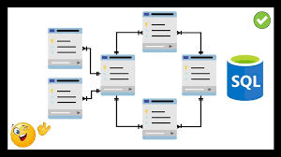
Base de datos relacional
Una base de datos relacional es una base de datos digital basada en el modelo relacional de datos propuesto por E. F. Codd en 1970.

Slide 15
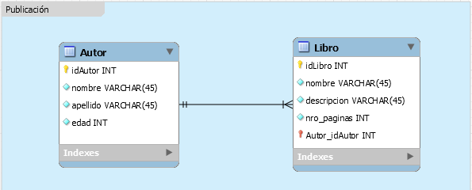
Base de datos relacional

Slide 16
1.1 RDBMS
Relational Database Management System
Notes:
https://www.analyticsvidhya.com/blog/2018/11/data-engineer-comprehensive-list-resources-get-started/

Slide 17
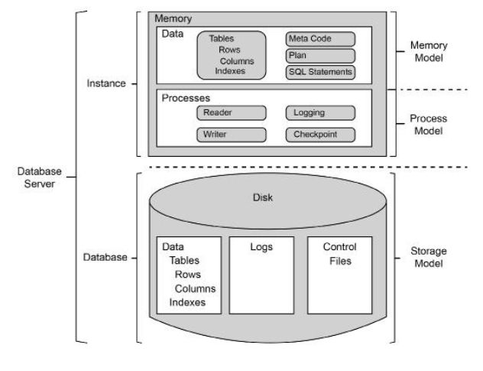

Slide 18
1.2 SQL
Structured Query Language
Notes:
https://www.analyticsvidhya.com/blog/2018/11/data-engineer-comprehensive-list-resources-get-started/

Slide 19

Lenguaje de consulta estructurado
Es un lenguaje estandarizado que sirve para definir y manipular los datos de una base de datos relacional.

Slide 20
2. Usando un RDBMS
(MySQL/PostgreSQL/SQLite)
Notes:
https://www.analyticsvidhya.com/blog/2018/11/data-engineer-comprehensive-list-resources-get-started/

Slide 21

SQLite
SQLite es una biblioteca en lenguaje C que implementa un motor de base de datos SQL pequeño, rápido, autónomo, de alta confiabilidad y con todas las funciones.

Slide 22
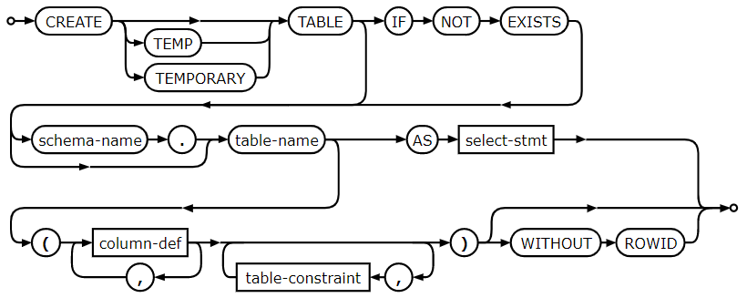
SQLite Síntaxis
https://sqlite.org/lang.html
https://www.sqlite.org/syntax.html

Slide 23
3. Mapeo de relaciones en las BD
Notes:
https://www.analyticsvidhya.com/blog/2018/11/data-engineer-comprehensive-list-resources-get-started/

Slide 24
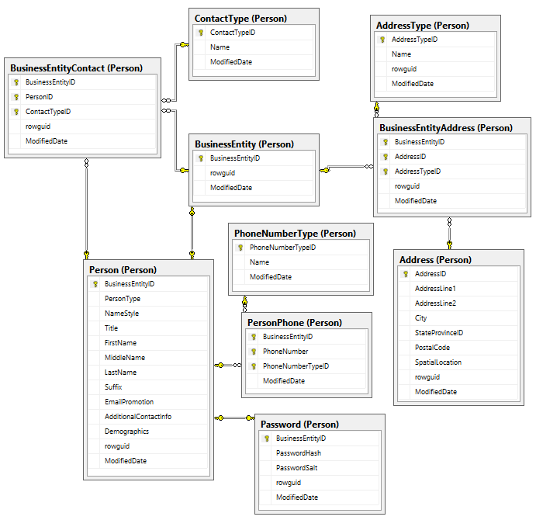
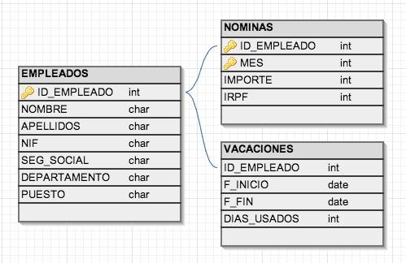
SQL Diagramas relacionales

Slide 25
4. CRUD SQL
Notes:
https://www.analyticsvidhya.com/blog/2018/11/data-engineer-comprehensive-list-resources-get-started/

Slide 26
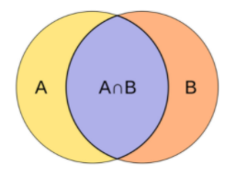
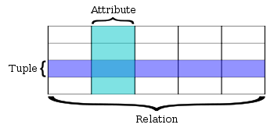
Data

Slide 27
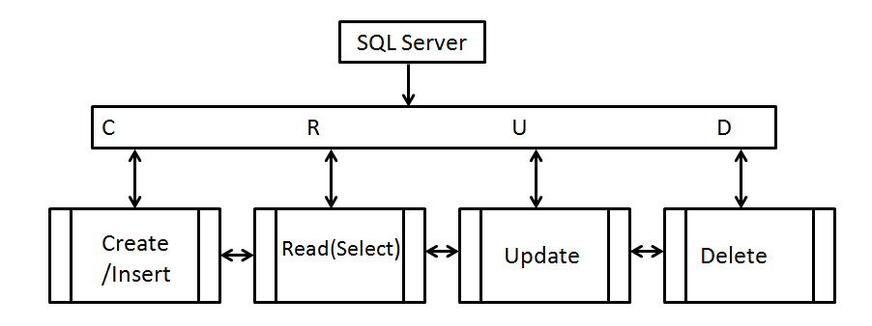
CRUD

Slide 28
CREATE
CREATE TABLE IF NOT EXISTS
User
(email text,
first_name text,
last_name text,
address text,
age integer,
PRIMARY KEY (email))
email | first_name | last_name | address | age

Slide 29
INSERT
INSERT INTO user
VALUES
('bob@example.com',
'Bob',
'Codd',
'123 Fantasy lane,
'Fantasy City',
31)
email | first_name | last_name | address | age
bob@example.com | Bob | Codd | 123 Fantasy lane, Fantasy City | 31

Slide 30
SELECT ( READ )
SELECT * FROM user ORDER BY age DESC
email | first_name | last_name | address | age
mali@devf.mx | b | b | méxico | 22

Slide 31
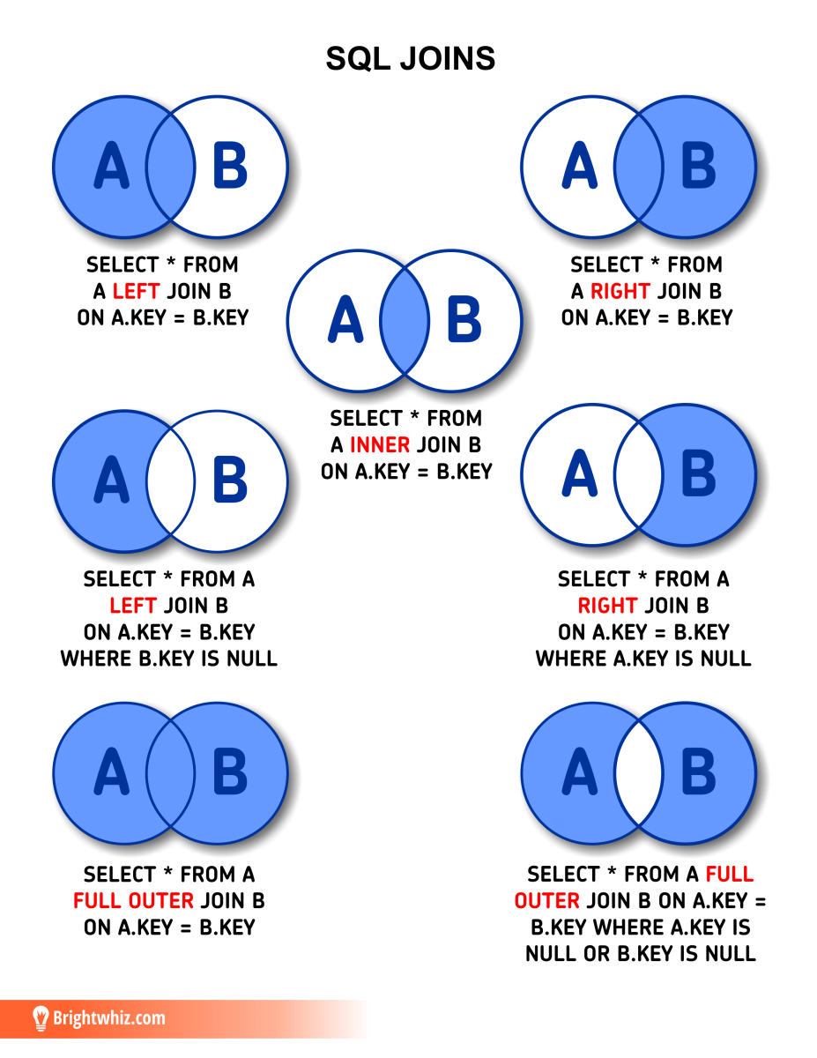
JOIN

Slide 32
5. CRUD SQL
Notes:
https://www.analyticsvidhya.com/blog/2018/11/data-engineer-comprehensive-list-resources-get-started/

Slide 33
CRUD

Slide 34
UPDATE
ALTER TABLE user ADD COLUMN gender text
UPDATE user SET gender='M'"

Slide 35
user_id | comment | email | first_name | last_name | address | age
mali@devf.mx | hola | mali@devf.mx | b | b | méxico | 22
mali@devf.mx | Que hay | mali@devf.mx | b | b | méxico | 22
mali@devf.mx | Que onda | mali@devf.mx | b | b | méxico | 22

Slide 36
DELETE
CREATE TABLE comments (
user_id text,
comments text,
FOREIGN KEY (user_id) REFERENCES user (email)
ON DELETE CASCADE
ON UPDATE NO ACTION
)
DELETE FROM user WHERE email='bob@example.com
email | first_name | last_name | address | age

Slide 37
5. Hands on SQL 😈
Notes:
https://www.analyticsvidhya.com/blog/2018/11/data-engineer-comprehensive-list-resources-get-started/

Slide 38
SQL “HELLO WORLD”
SELECT 'Hello, World';
Notes:
Statement

Slide 39
SELECT

Slide 40
SELECT statement en SQLITE
SELECT * FROM Country;
SELECT * FROM Country ORDER BY Name;
SELECT Name, LifeExpectancy FROM Country ORDER BY Name;
SELECT Name, LifeExpectancy AS "Life Expectancy" FROM Country ORDER BY Name;

Slide 41
SELECT statement en SQLITE
SELECT Name, Continent, Region FROM Country;
SELECT Name, Continent, Region FROM Country WHERE Continent = 'Europe';
SELECT Name, Continent, Region FROM Country WHERE Continent = 'Europe' ORDER BY Name;
SELECT Name, Continent, Region FROM Country WHERE Continent = 'Europe' ORDER BY Name LIMIT 5;
SELECT Name, Continent, Region FROM Country WHERE Continent = 'Europe' ORDER BY Name LIMIT 5 OFFSET 5;

Slide 42
COUNT

Slide 43
COUNT statement en SQLITE
SELECT COUNT(*) FROM Country;
SELECT COUNT(*) FROM Country WHERE Population > 1000000;
SELECT COUNT(*) FROM Country WHERE Population > 100000000;
SELECT COUNT(*) FROM Country WHERE Population > 100000000 AND Continent = 'Europe' ;

Slide 44
INSERT
Usaremos esta vez test.db (está en el drive)

Slide 45
INSERT statement en SQLITE
INSERT INTO customer (name, address, city, state, zip) VALUES ('Fred Flintstone', '123 Cobblestone Way', 'Bedrock', 'CA', '91234');
INSERT INTO customer (name, city, state) VALUES ('Jimi Hendrix', 'Renton', 'WA');

Slide 46
INSERT
Seguimos usando test.db (sigue estando donde mismo)

Slide 47
INSERT statement en SQLITE
UPDATE customer SET address = '123 Music Avenue', zip = '98056' WHERE id = 5;
UPDATE customer SET address = '2603 S Washington St', zip = '98056' WHERE id = 5;
UPDATE customer SET address = NULL, zip = NULL WHERE id = 5;

Slide 48
DELETE
Seguimos usando test.db (sigue estando donde mismo)

Slide 49
INSERT statement en SQLITE
SELECT * FROM customer WHERE id = 4;
DELETE FROM customer WHERE id = 4;
SELECT * FROM customer;
DELETE FROM customer WHERE id = 5;
SELECT * FROM customer;

Slide 50
SELECT
COUNT
INSERT
DELETE

Slide 51
JOIN 🔥🔥
Aqui sacaremos la verdadera funcionalidad de tener datos relacionados

Slide 52
JOIN Recap

Slide 53
JOIN statement en SQLITE
Primero creamos un par de tablas
CREATE TABLE left ( id INTEGER, description TEXT );
CREATE TABLE right ( id INTEGER, description TEXT );

Slide 54
JOIN statement en SQLITE
INSERT INTO left VALUES ( 1, 'left 01' );
INSERT INTO left VALUES ( 2, 'left 02' );
INSERT INTO left VALUES ( 3, 'left 03' );
INSERT INTO left VALUES ( 4, 'left 04' );
INSERT INTO left VALUES ( 5, 'left 05' );
INSERT INTO left VALUES ( 6, 'left 06' );
INSERT INTO left VALUES ( 7, 'left 07' );
INSERT INTO left VALUES ( 8, 'left 08' );
INSERT INTO left VALUES ( 9, 'left 09' );
INSERT INTO right VALUES ( 6, 'right 06' );
INSERT INTO right VALUES ( 7, 'right 07' );
INSERT INTO right VALUES ( 8, 'right 08' );
INSERT INTO right VALUES ( 9, 'right 09' );
INSERT INTO right VALUES ( 10, 'right 10' );
INSERT INTO right VALUES ( 11, 'right 11' );
INSERT INTO right VALUES ( 11, 'right 12' );
INSERT INTO right VALUES ( 11, 'right 13' );
INSERT INTO right VALUES ( 11, 'right 14' );

Slide 55
JOIN statement en SQLITE
Una vez insertados todos esos valores, verifiquemos ambas tablas
SELECT * FROM left;
SELECT * FROM right;
OJO AQUI : aqui es donde la magia pasa
SELECT l.description AS left, r.description AS right
FROM left AS l
JOIN right AS r ON l.id = r.id;

Slide 56
JOIN statement en SQLITE
Restaurar DB
DROP TABLE left;
DROP TABLE right;

Slide 57
JOIN 🔥🔥🔥
Usaremos la tabla Sale en un ejemplo real para hacer joins

Slide 58
JOIN statement en SQLITE
Veamos que hay dentro de las tablas que queremos generar el query
SELECT * FROM sale;
SELECT * FROM item;
Hagamos la consulta en ambas tablas:
SELECT s.id AS sale, i.name, s.price
FROM sale AS s
JOIN item AS i ON s.item_id = i.id ;

Slide 59
JOIN statement en SQLITE
Con una no nos bastó, hagamos OTRA query con JOIN
Hagamos la consulta en ambas tablas:
SELECT s.id AS sale, s.date, i.name, i.description, s.price
FROM sale AS s
JOIN item AS i ON s.item_id = i.id;

Slide 60
JOIN statement en SQLITE
Con dos tablas no nos bastó, hagamos OTRA JOIN query con 3 tablas
Hagamos la consulta en ambas tablas:
SELECT c.name AS Cust, c.zip, i.name AS Item, i.description, s.quantity AS Quan, s.price AS Price
FROM sale AS s
JOIN item AS i ON s.item_id = i.id
JOIN customer AS c ON s.customer_id = c.id
ORDER BY Cust, Item;

Slide 61
Módulo IV: Data Wrangling.

